Slide 1
Tribal Assistance Coordination Group (TAC-G)
Federal Partnerships During Emergencies

Slide 2
TAC-G Primary Partners
Indian Affairs – OHSES (BIA & BIE)
Indian Health Service (IHS)
FEMA (National Tribal Liaison)

Slide 3
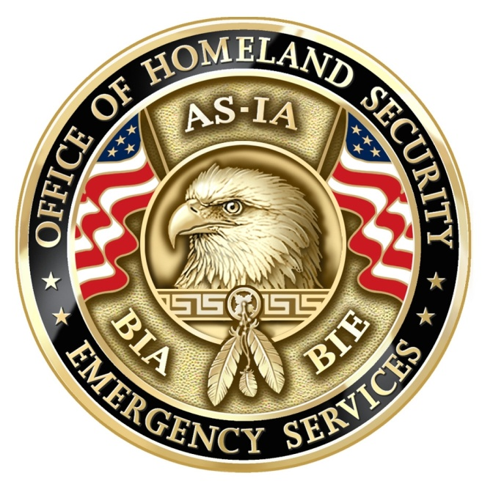
Indian Affairs
Office of Homeland Security & Emergency Services

Slide 4
History of OHSES
2001 Emergency Coordinator Position established in ASIA
2002 Homeland Security Position established in BIA (Position was under BIA-OJS)
2003 Homeland Security Position realigned in ASIA
2006 Office of Homeland Security and Emergency Services established

Slide 5
Office Activities
Continuity of Operations Plans (COOP)
National Response Framework (NRF) Tribal Annex & ESF #15
Pandemic Flu Preparedness
National Preparedness System (NPS) Integrated Planning System (IPS) & Comprehensive Preparedness Guide (CPG) Implementation
Federal Communication Commission (FCC) Coordination
Government Emergency Telecommunications Service (GETS) & Wireless Priority System (WPS)

Slide 6
Office Activities (cont)
National Infrastructure Protection Plan (NIPP)
Tribal Assistance Coordination Group (TAC-G)
Tribal Information Sharing Environment (ISE)
Coordination of National Incident Management System (NIMS) & ICS Requirements
Coordination and support of Ancillary Essential Support Functions (ESF)

Slide 7
Indian Affairs EM Structure
AS-IA has two personnel for EM (All Fed mandates plus everything else)
BIA 12 Regional Emergency Management Coordinators (Collateral duty assignment)
BIE has three School Safety Specialists assigned to the Associate Deputy Directors
*(Two hired one position to be filled)*

Slide 8
Indian Health Service
12 Area Emergency Management Points of Contact (EMPOCs)
Positions are collateral duty assignment

Slide 9
FEMA Tribal Liaisons
One for most FEMA Regions and a National Tribal Liaison
Only National and Region IX are full time Tribal Liaisons positions

Slide 10
Challenges for Tribal Governments
90% of emergencies/disasters that affect Tribal Governments will not receive a Presidential Emergency and/or Disaster Declaration
Many Federal Departments and Agencies do not have clear policies regarding emergency assistance to Tribal Governments with a PED/PDD
Federal D&As don’t always have the necessary reimbursable agreements in place pre-disaster

Slide 11
Overcoming the Challenges
Establishing good working relationships prior to a disaster can make all the difference in how much assistance can be offered and available from Federal partners when your need is greatest.
MOUs/MOAs are the best way to help insure the requested assistance/resources are available during an emergency

Slide 12
Why the TAC-G
Poor Communication during response to Katrina and Rita
Began with a meeting to get IA, IHS and FEMA communicating and coordinating response efforts (BP)
First significant success during Ike and Gustav

Slide 13
Tribal Assistance Coordination Group (TAC-G)
The TAC-G defines how Indian Affairs (IA), the Indian Health Service (IHS), and the Federal Emergency Management Agency (FEMA) intend to operate within during a disaster or emergency.
Provides strategic guidance and operational context to work within an interagency framework that supports the National Incident Management System (NIMS) and respects the application of the National Response Framework (NRF).
It also reinforces support of Emergency Support Function (ESF) #15 and the NRF Tribal Annex.

Slide 14
Tribal Assistance Coordination Group (TAC-G) con’t
The TAC-G ensures coordination with tribal governments on all aspects of incident management operations and provides a mechanism to work closely with DHS to ensure tribal relations actions are carried out in accordance with established Federal Government policies and procedures.
Current Partners include: Indian Affairs, IHS, FEMA, DOI, ACF, HUD, DHS , USDA

Slide 15
New Partners
DHS Office of Emergency Communication
USCG
FEMA Mitigation Directorate
National Archives and Records Administration

Slide 16
TAC-G Charter
Establishes a representative from all Executive Branch Departments and Agencies (Be careful what you wish for)
Creates a Tribal Advisory Group

Slide 17
2010 Incidents
Navajo Nation Snow Emergency
Cheyenne River severe weather
Los Coyotes Radio Issues
Rocky Boy’s flooding
Deepwater Horizon Incident

Slide 18
Regional Emergency Management Workshops
BIA and IHS are partnering to present emergency management workshops beginning in 2011 to engage regional Federal D&A representatives
The workshops will have “tracks” for BIA and IHS personnel as well as tribal emergency management personnel
A combined open forum will be conducted at the end of the workshop

Slide 19
Questions?
Patrick Vacha
Indian Affairs
Emergency Management Coordinator
202-208-4438 Office
202-577-5918 Mobile
patrick.vacha@bia.gov

